Slide 1
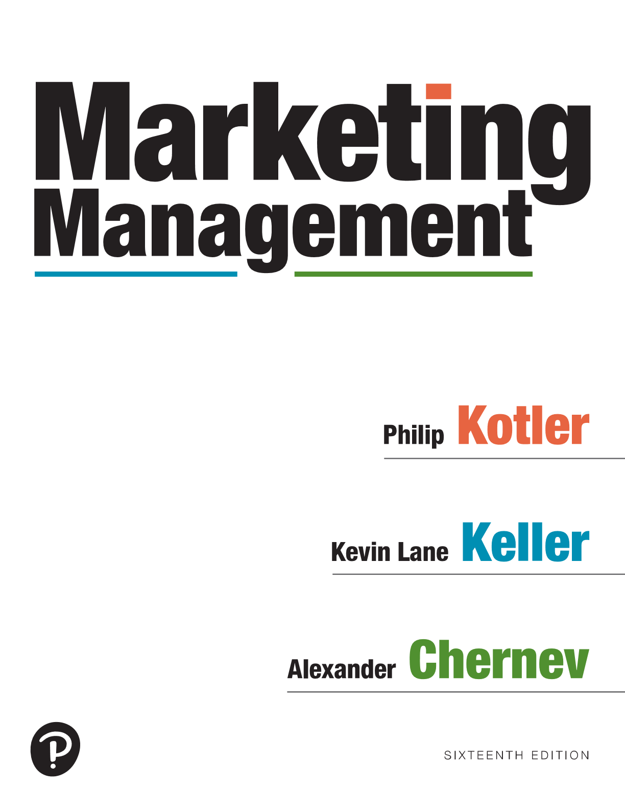

Marketing Management
Sixteenth Edition
Chapter 7
Crafting a Customer Value Proposition and Positioning
Copyright © 2022, 2016, 2012 Pearson Education, Inc. All Rights Reserved
Notes:
If this PowerPoint presentation contains mathematical equations, you may need to check that your computer has the following installed:
1) MathType Plugin
2) Math Player (free versions available)
3) NVDA Reader (free versions available)

Slide 2
Learning Objectives
7.1 Explain how a company should develop a value proposition and a positioning strategy.
7.2 Describe how a company chooses a frame of reference.
7.3 Discuss how a company identifies points of parity and points of difference.
7.4 Define the key strategies for creating a sustainable competitive advantage.
7.5 Identify alternative strategies to communicate the positioning of a company’s offerings.

Slide 3

Developing a Value Proposition (1 of 5)
Create value across three domains:
Functional value
Psychological value
Monetary value
Notes:
How do customers ultimately make choices? They tend to be value maximizers, within the bounds of search costs and limited knowledge, mobility, and income. Customers choose—for whatever reason—the offer they believe will deliver the highest value and act on it.
Depending on the needs of customers, an offering can create value across three domains: functional, psychological, and monetary.
Functional value reflects the benefits and costs that are directly related to an offering’s performance.
Psychological value encompasses the psychological benefits and costs associated with the offering. Psychological value extends beyond the functional benefits to create emotional benefits for target customers.
Monetary value includes the financial benefits and costs associated with the offering.

Slide 4
Developing a Value Proposition (2 of 5)
Total customer benefit
The perceived value of the bundle of functional, psychological, and monetary benefits customers expect from a given market offering because of the product, service, and image
Notes:
Across all three dimensions—functional, psychological, and monetary—customer value is the difference between the prospective customer’s evaluation of all the benefits and costs of an offering and her or his evaluation of the costs and benefits of the perceived alternatives.

Slide 5
Developing a Value Proposition (3 of 5)
Total customer cost
The perceived bundle of functional, psychological, and monetary costs customers will incur in evaluating, obtaining, using, and disposing of the given market offering
Notes:
Across all three dimensions—functional, psychological, and monetary—customer value is the difference between the prospective customer’s evaluation of all the benefits and costs of an offering and her or his evaluation of the costs and benefits of the perceived alternatives.

Slide 6
Developing a Value Proposition (4 of 5)
Customer value proposition
Based on the difference between benefits the customer gets and the costs he or she assumes for different choices
Notes:
The customer value proposition is based on the difference between benefits the customer gets and the costs he or she assumes for different choices.
The marketer can increase the value of the offering by raising functional, psychological, and monetary benefits and/or reducing the corresponding costs

Slide 7
Developing a Value Proposition (5 of 5)
Customer value analysis
Reveals the company’s strengths and weaknesses relative to those of various competitors
Notes:
Very often, managers conduct a customer value analysis to reveal the company’s strengths and weaknesses relative to those of various competitors.

Slide 8
Customer Value Analysis
Identify the relevant attributes and benefits that customers value
Assess the relative importance of these attributes and benefits
Assess the company’s and competitors’ performance on the key attributes/benefits
Monitor customer value over time
Notes:
Very often, managers conduct a customer value analysis to reveal the company’s strengths and weaknesses relative to those of various competitors.
The steps in this analysis are as follows:
1. Identify the relevant attributes and benefits that customers value. Customers are asked what attributes, benefits, and performance levels they look for in choosing a product and vendors. Attributes and benefits should be defined broadly to encompass all the inputs to customers’ decisions.
2. Assess the relative importance of these attributes and benefits. Customers are asked to rate the importance of different attributes and benefits. If their ratings diverge too much, the marketer should cluster the attributes and benefits into different segments.
3. Assess the company’s and competitors’ performance on the key attributes/benefits. If the company’s offer exceeds the competitor’s offer on all important attributes and benefits, the company can charge a higher price and thereby earning higher profits, or it can charge the same price and thereby gain more market share.
4. Monitor customer value over time. The company must periodically redo its studies of customer values and competitors’ standings as the economy, technology, and product features change.
Customer value analysis suggests that the seller must assess the total customer benefit and total customer cost associated with each competitor’s offer in order to know how its own offer rates in the buyer’s mind.
It also implies that the seller at a disadvantage has two alternatives: increase total customer benefit or decrease total customer cost.

Slide 9

Developing a Positioning Strategy
Positioning
The act of designing a company’s offering and image to occupy a distinctive place in the minds of the target market
Notes:
The goal is to instill the brand in the minds of consumers to maximize the potential benefit to the firm.
Effective positioning helps guide marketing strategy by clarifying the brand’s essence, identifying the goals it helps the consumer achieve, and showing how it does so in a unique way. Everyone in the organization should understand the brand positioning and use it as the context for making decisions.

Slide 10
Choosing a Frame of Reference
Frame of reference
Serves as a benchmark against which customers can evaluate the benefits of a company’s offering
Notes:
Decisions about the frame of reference are closely linked to target market decisions.
Deciding to target a certain type of consumer can define the nature of competition because certain firms have decided to target that segment in the past (or plan to do so in the future) or because consumers in that segment may already look to certain products or brands in their purchase decisions.
A good starting point in defining a competitive frame of reference for brand positioning is category membership—the products or sets of products with which a brand competes and that function as close substitutes.
The range of a company’s actual and potential competitors, however, can be much broader than the obvious ones.

Slide 11
Points of Difference and Points of Parity (1 of 5)
Points of difference (P O D s)
Attributes/benefits that consumers strongly associate with a brand, positively evaluate, and believe they could not find to the same extent with a competitive brand
Notes:
Associations that make up points-of-difference can be based on virtually any type of attribute or benefit. Strong brands often have multiple points-of-difference.

Slide 12

Points of Difference and Points of Parity (2 of 5)
P O D criteria
Desirable
Deliverable
Differentiating
Notes:
Three criteria determine whether a brand association can truly function as a point-of-difference: desirability, deliverability, and differentiability. Desirable to consumer. Consumers must see the brand association as personally relevant to them.
Deliverable by the company. The company must have the internal resources and commitment to feasibly and profitably create and maintain the brand association in the minds of consumers. The product design and marketing offering must support the desired association. Differentiating from competitors.
Finally, consumers must see the brand association as distinctive and superior to relevant competitors.

Slide 13
Points of Difference and Points of Parity (3 of 5)
Points of parity (P O P s)
Attribute/benefit associations that are not necessarily unique to the brand but may in fact be shared with other brands
Notes:
Regardless of the source of perceived weaknesses, if, in the eyes of consumers, a brand can “break even” in those areas where it appears to be at a disadvantage and achieve advantages in other areas, it should be in a strong—and perhaps unbeatable—competitive position.

Slide 14

Points of Difference and Points of Parity (4 of 5)
P O P forms
Category
Correlational
Competitive
Notes:
POP associations come in three basic forms: category, correlational, and competitive.
Category points-of-parity are attributes or benefits that consumers view as essential to a legitimate and credible offering within a certain product or service category. In other words, they represent necessary—but not sufficient— conditions for brand choice.
Correlational points-of-parity are potentially negative associations that arise from the existence of positive associations for the brand.
Competitive points-of-parity are associations designed to overcome perceived weaknesses of the brand in light of competitors’ points-of-difference.

Slide 15

P O P versus P O D
Multiple Frames of Reference
Straddle Positioning
Notes:
It is not uncommon for a brand to identify more than one actual or potential competitive frame of reference, if competition widens or the firm plans to expand into new categories.
For example, Starbucks could define very distinct sets of competitors, suggesting different possible POPs and PODs as a result: some potential POPs and PODs for Starbucks are shared across competitors; others are unique to a particular competitor.
Occasionally, a company will be able to straddle two frames of reference with one set of points-of-difference and points-of-parity. In these cases, the points-of-difference for one category become points-of-parity for the other and vice versa.
Straddle positions allow brands to expand their market coverage and potential customer base.

Slide 16
Points of Difference and Points of Parity (5 of 5)
Perceptual maps
Visual representations of consumer perceptions and preferences
Notes:
Perceptual maps, also called positioning maps, may be useful for choosing specific benefits as POPs and PODs to position a brand. Perceptual maps are visual representations of consumer perceptions and preferences. They provide quantitative pictures of market situations and the way consumers view different products, services, and brands along various dimensions.
By overlaying consumer preferences on brand perceptions, marketers can reveal “holes” or “openings” that suggest unmet consumer needs and marketing opportunities.

Slide 17
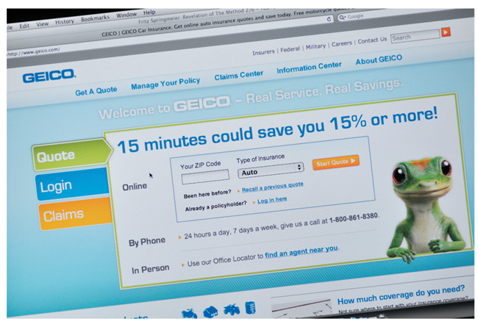
Creating a Sustainable Advantage (1 of 2)
Competitive advantage
The ability to perform in one or more ways that competitors cannot or will not match
Leverageable advantage
Notes:
To build a strong brand and avoid the commodity trap, marketers must start with the belief that it is possible to differentiate an offering by creating a sustainable competitive advantage. Few competitive advantages are inherently sustainable; in the long run, they are often replicated by the competition. Instead, a competitive advantage may be leverageable. A leverageable advantage is one that a company can use as a springboard to new advantages, much as Microsoft has leveraged its operating system with Microsoft Office and networking applications. In general, a company that hopes to endure must be in the business of continuously inventing new advantages that can serve as the basis of points of difference.

Slide 18
Creating a Sustainable Advantage (2 of 2)
Three core strategies:
Differentiate on an existing attribute
Introduce a new attribute
Build a strong brand
Notes:
Three core strategies are integral to designing a value proposition that makes an offering stand out from the competition. These are to differentiate on an existing attribute, introduce a new attribute, and build a strong brand.

Slide 19
Communicating the Positioning (1 of 5)
Positioning statement
Communicating an offering’s category membership along with points of parity and points of difference, and developing a narrative to convey the offering’s positioning
Notes:
Once they have fashioned the brand positioning strategy, marketers should communicate it to everyone in the organization so that it will guide their words and actions.
This is usually achieved by developing a positioning statement. The key aspects of crafting an effective positioning statement—communicating an offering’s category membership along with points of parity and points of difference, and developing a narrative to convey the offering’s positioning.

Slide 20
Communicating the Positioning (2 of 5)
Crafting a positioning statement
Attributes that describe the offering versus benefits delivered by the attributes
Notes:
A positioning statement clearly articulates the offering’s target customers and the key benefit that will provide customers with a reason to choose the company’s offering.
Multiple attributes may support a certain benefit, and they may change over time. Attributes provide “reasons to believe” or “proof points” for why a brand can credibly claim it offers certain benefits.

Slide 21

Communicating the Positioning (3 of 5)
Communicating category membership
Announce category benefits
Compare to exemplars
Rely on the product descriptor
Notes:
Category membership may be obvious.
Target customers are aware that Maybelline is a leading brand of cosmetics, Cheerios is a leading brand of cereal, McKinsey is a leading consulting firm, and so on. But when a product is new, marketers must inform consumers of the brand’s category membership.
Sometimes consumers may know the category membership but not be convinced that the brand is a valid member of the category.
They may be aware that HP produces digital cameras, but they may not be certain whether HP cameras are in the same class as those made by Canon, Nikon, and Sony. In this instance, HP might find it useful to reinforce category membership.
The typical approach to positioning is to inform consumers of a brand’s membership before stating its point of difference.
Presumably, consumers need to know what a product is and what function it serves before deciding whether it is superior to the brands against which it competes. For new products, initial advertising often concentrates on creating brand awareness, and subsequent advertising attempts to create the brand image.

Slide 22
Communicating the Positioning (4 of 5)
Communicating conflicting benefits
Challenge: consumers want to maximize both of the negatively correlated attributes or benefits
Develop a product or service that performs well on both dimensions
Launch two different marketing campaigns
Notes:
As we saw above, one common challenge in positioning is that many of the benefits that make up points of parity and points of difference are negatively correlated.
The challenge is that consumers typically want to maximize both of the negatively correlated attributes or benefits. Much of the art and science of marketing consists of dealing with trade-offs, and positioning is no different. The best approach clearly is to develop a product or service that performs well on both dimensions.
Other approaches include launching two different marketing campaigns, each devoted to a different brand attribute or benefit: one linking the brand to a person, place, or thing that possesses the right kind of equity to establish an attribute or benefit as a POP or POD; and the other convincing consumers that the negative relationship between attributes and benefits, if they consider it differently, is in fact positive

Slide 23
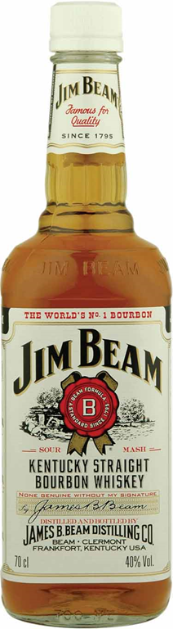
Communicating the Positioning (5 of 5)
Positioning as storytelling
Narrative brandling
Setting
Cast
Narrative arc
Language
Primal branding
Notes:
Rather than outlining specific attributes or benefits, some marketing experts describe positioning a brand as telling a narrative or story. Companies like the richness and imagination they can derive from thinking of the story behind a product or service. Based on literary convention and brand experience, the following framework is offered for a brand story:
Setting. The time, place, and context
Cast. The brand as a character, including its role in the life of the audience, its relationships and responsibilities, and its history or creation myth
Narrative arc. The way the narrative logic unfolds over time, including actions, desired experiences, defining events, and the moment of epiphany
Language. The authenticating voice, metaphors, symbols, themes, and leitmotifs

Slide 24
Discussion Questions (1 of 2)
Discuss the positioning strategies of C V S and Walgreens.
What value do they offer consumers?
How might the two chains define their frame of reference?
How would you describe their points of difference and points of parity relative to the competition?

Slide 25
Discussion Questions (2 of 2)
Consider your college or university’s positioning statement.
How does your college or university describe its attributes and the benefits it provides to the buyer (in this case the student)?
How would you describe your college or university’s competitive advantage?

Slide 26

Copyright
This work is protected by United States copyright laws and is provided solely for the use of instructors in teaching their courses and assessing student learning. Dissemination or sale of any part of this work (including on the World Wide Web) will destroy the integrity of the work and is not permitted. The work and materials from it should never be made available to students except by instructors using the accompanying text in their classes. All recipients of this work are expected to abide by these restrictions and to honor the intended pedagogical purposes and the needs of other instructors who rely on these materials.

